Slide 1




How to Start a WordPress E-commerce site using WooCommerce
@SzeLiu
#WCMIA
May 30, 2015

Slide 2

Agenda
Preparation
Installation
Settings
Products
Other

Slide 3
Preparation
Paperwork
Business license
Seller’s permit
Sales tax
Server requirement
PHP 5.2.4 or greater (WordPress)
MySQL 5.0 or greater (WordPress)
The mod_rewrite Apache module (for permalinks) (WordPress)
fsockopen support (for payment gateway IPN access)
An SSL certificate if you choose to install any direct payment gateways (optional)
Some plugins for WooCommerce require cURL (optional)
Some plugins for WooCommerce require SOAP (optional)
Installing WordPress
http://codex.wordpress.org/Installing_WordPress
Installing a theme
https://codex.wordpress.org/Using_Themes
WooCommerce compatible

Slide 4
Agenda
Preparation
Installation
Settings
Products
Other

Slide 5


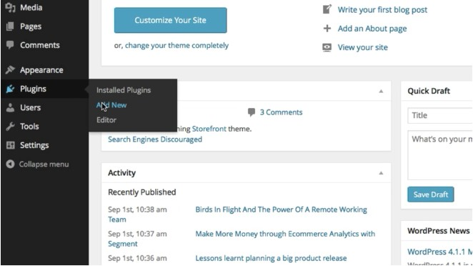
Installation – Finding WooCommerce
Go to Plugins and Add New

Slide 6
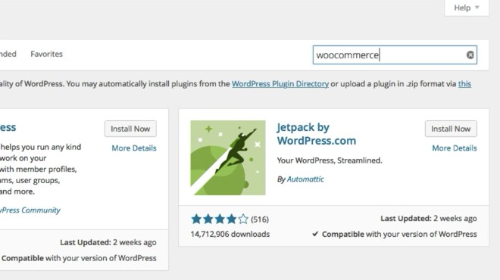

Installation – Finding WooCommerce
Type “woocommerce in the search box and hit “enter”

Slide 7
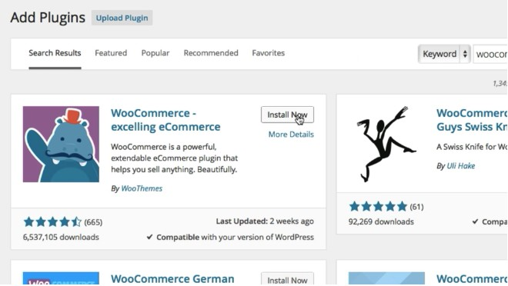

Installation – Finding WooCommerce
Click “install now” on the WooCommerce plugin

Slide 8
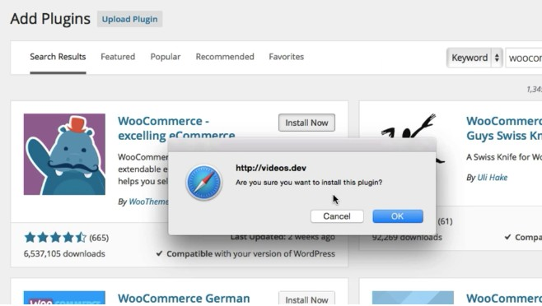

Installation – Finding WooCommerce
Click “OK” to install the plugin

Slide 9
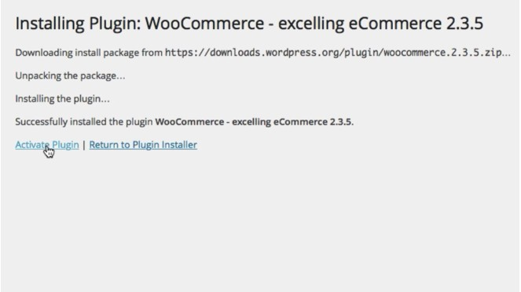

Installation – WooCommerce Activation
Click “Activate Plugin” to activate the plugin

Slide 10
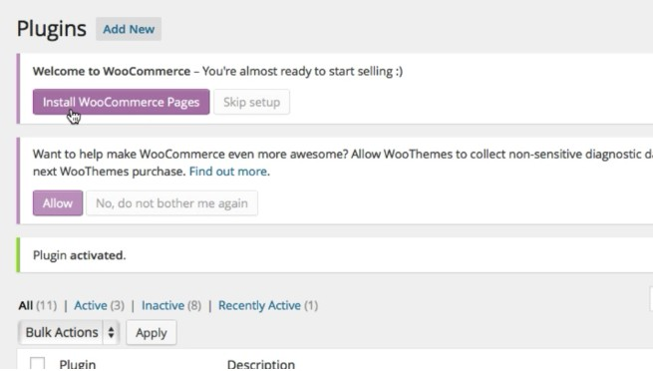

Installation – WooCommerce Activation
Click “Install WooCommerce Pages” to install the default WooCommerce pages

Slide 11
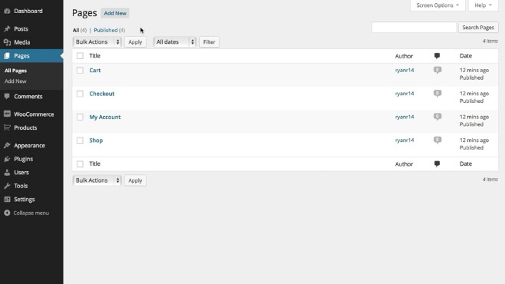




Installation – WooCommerce Activation
Pages have been installed

Slide 12
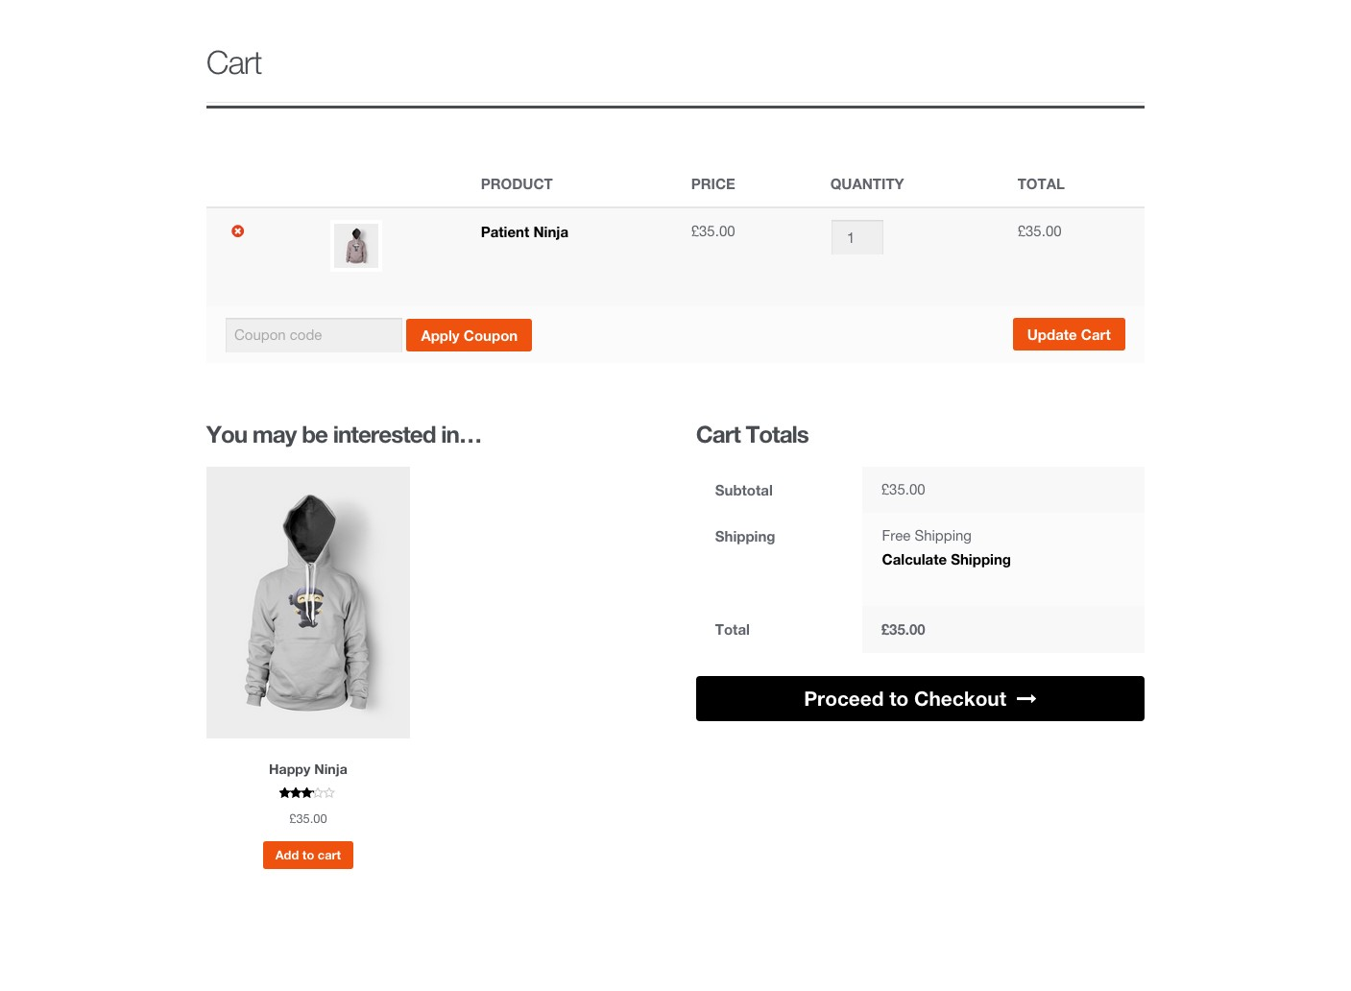
Installation – Cart Page

Slide 13
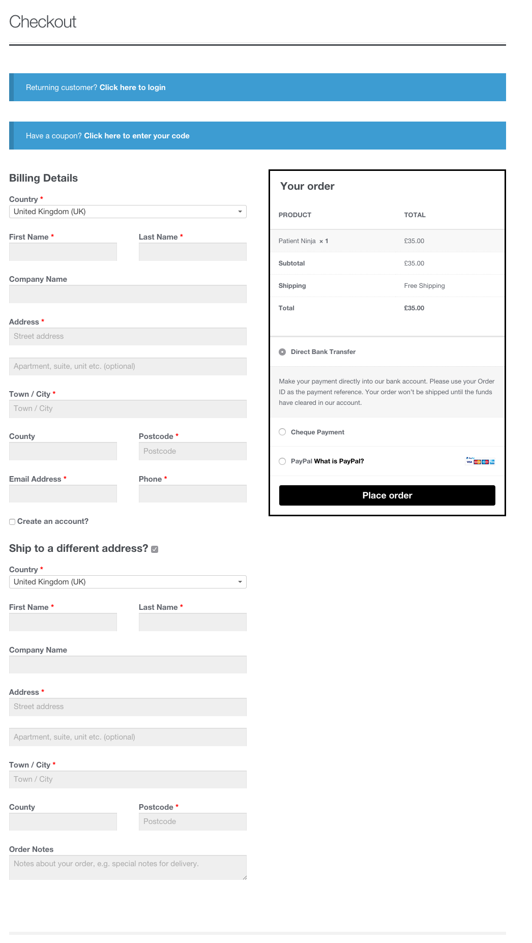
Installation – Checkout Page

Slide 14
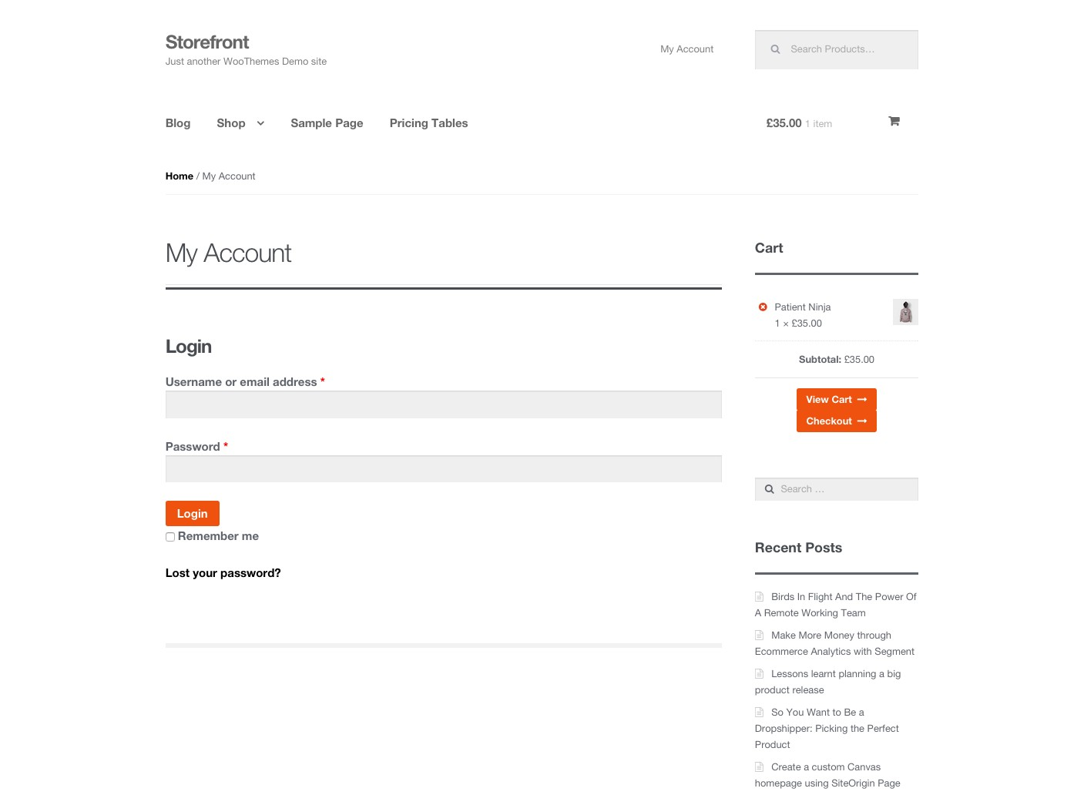
Installation – My Account Page

Slide 15
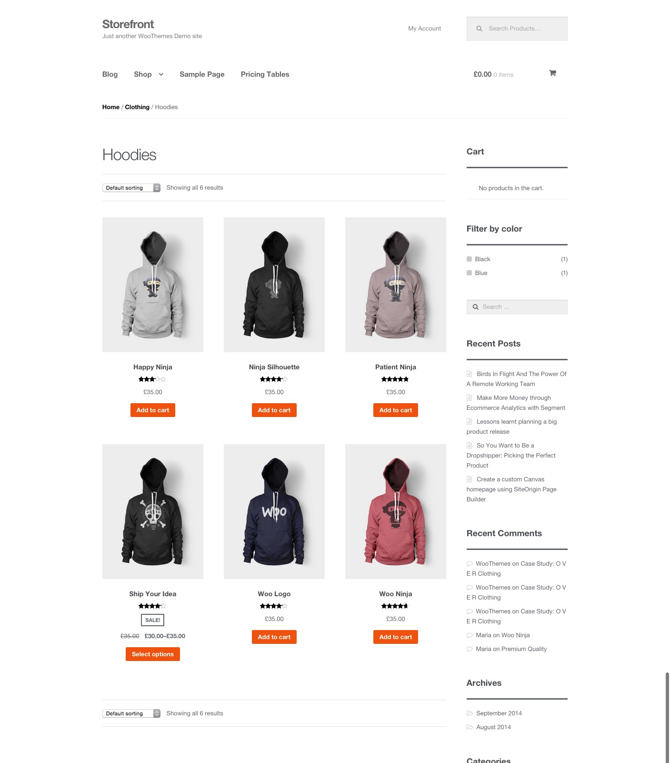
Installation – Shop Page

Slide 16


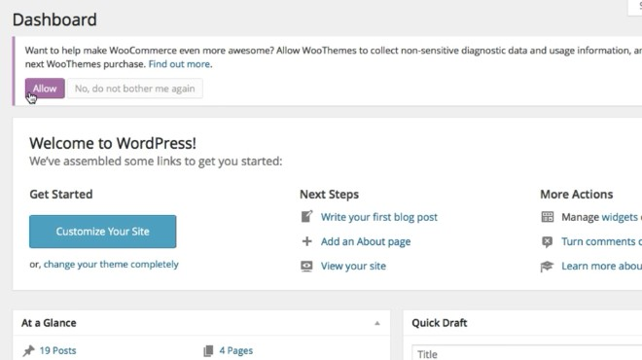
Installation – WooCommerce Activation
Click “Allow” if you allow WooThemes to collect non-­‐sensitive data for diagnostic purposes or “No, do not bother me again” if otherwise.

Slide 17

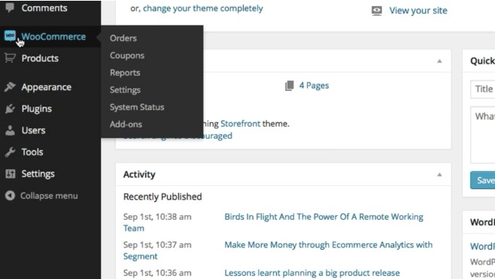

Installation – Changes to the Sidebar
Once WooCommerce is installed, you will see it on the sidebar and its diﬀerent components.

Slide 18

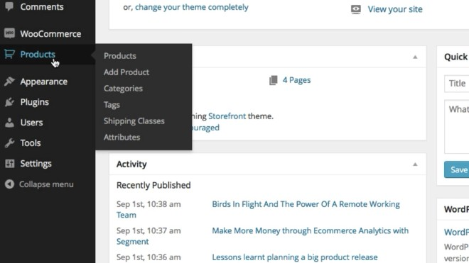

Installation – Changes to the Sidebar
Products and its components are also installed on the sidebar.

Slide 19
Agenda
Preparation
Installation
Settings
Products
Other

Slide 20
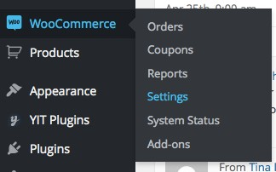


Settings – General Options

Slide 21
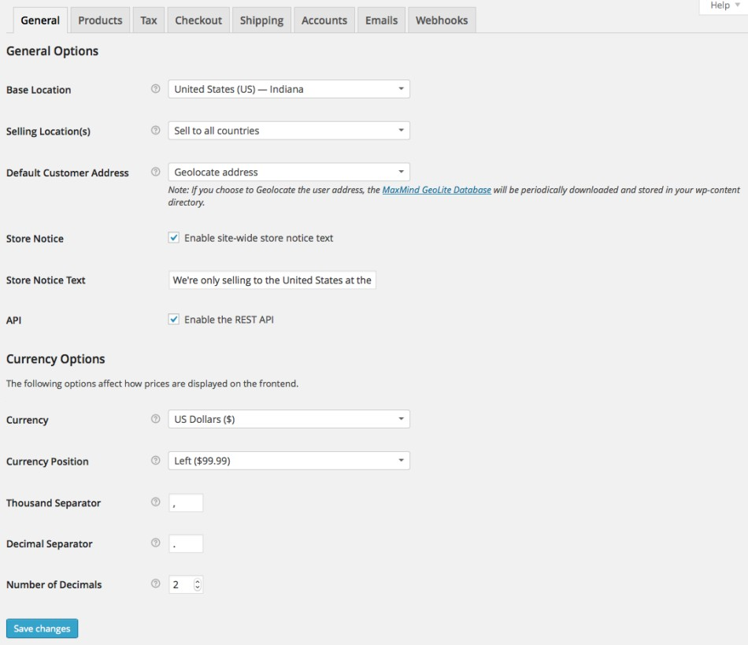

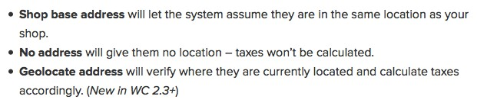

Settings – General Options
You can enable it to access your store data from outside of WordPress, for example from the WooCommerce iOS app or other external apps.

Slide 22
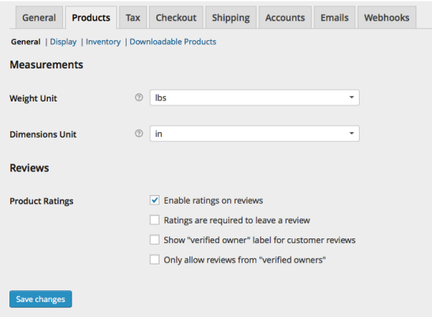
Settings – Products - General

Slide 23
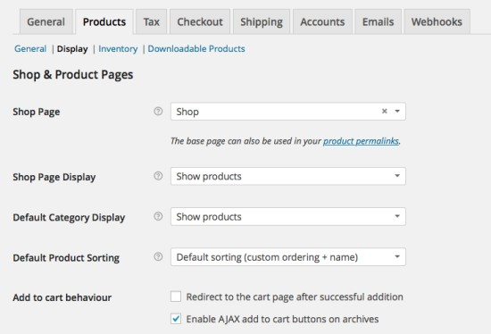



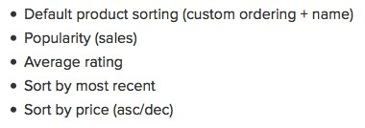
Settings – Products – Display
Select to show products, subcategories or both

Slide 24
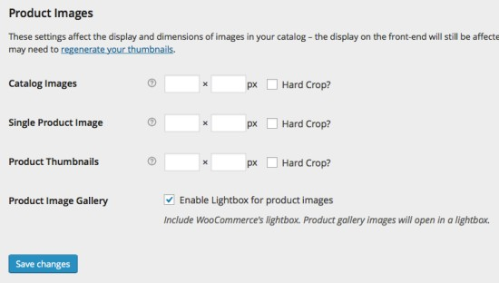
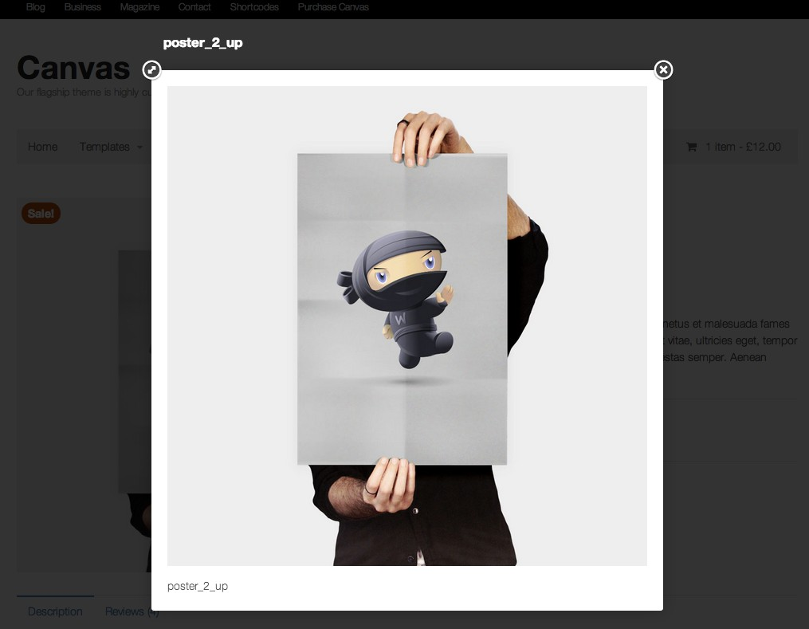

Settings – Products

Slide 25
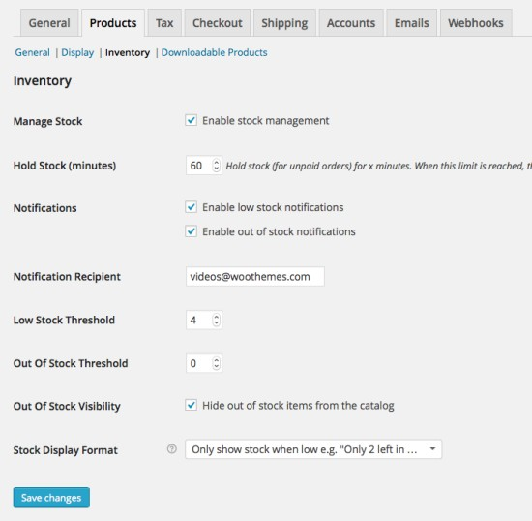
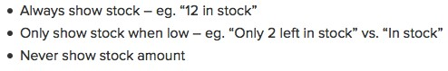

Settings – Products – Inventory

Slide 26
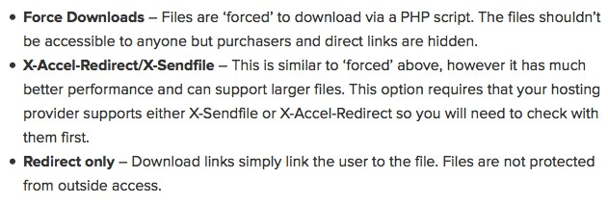
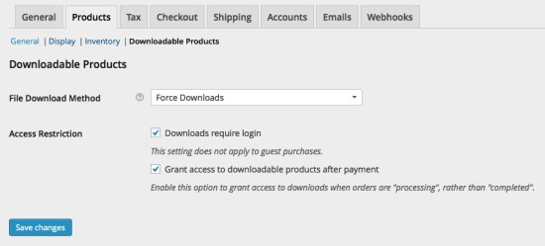

Settings – Products – Downloadable Products

Slide 27
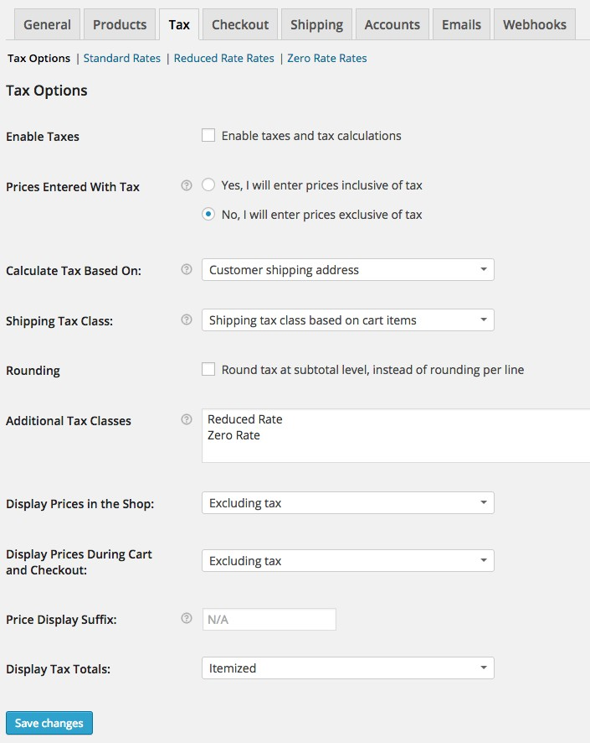

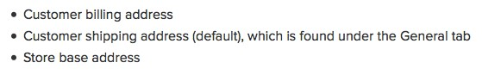


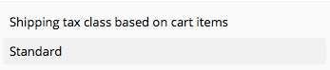
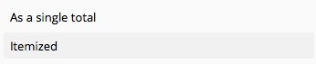

Settings – Tax – Tax Options
Enable Taxes by checking the box

Slide 28
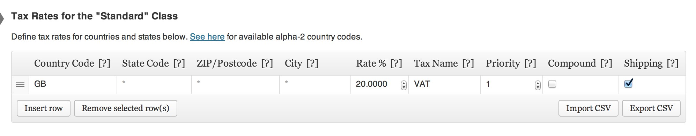
Settings – Tax – Standard Rates
9. Check if tax also applies to shipping
1. Enter your country code. For example: US
3. Enter your zip code. For example: 33139
7. Enter a priority if you have multiple tax rates
5. Enter your tax rate
2. Enter your state code. For example: FL
4. Enter your city. For 6. Enter a tax name example: Miami
8. Check if tax is compounded

Slide 29
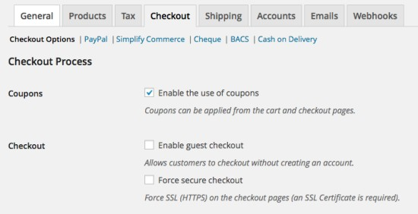

Settings – Checkout – Checkout Options
Highly Recommended if SSL Certiﬁcate is in place.

Slide 30
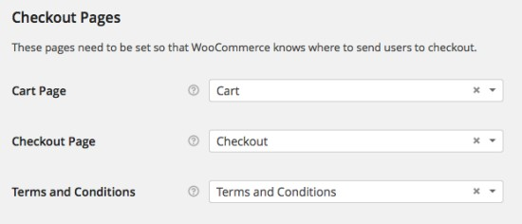
Settings – Checkout – Checkout Options (cont’d)

Slide 31
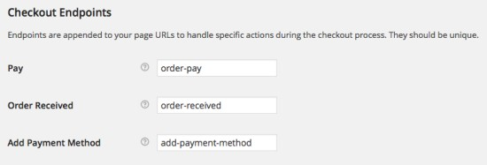
Settings – Checkout – Checkout Options (cont’d)

Slide 32
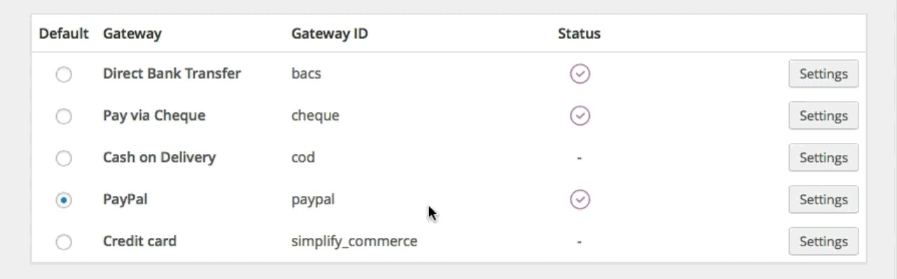
Settings – Checkout – Checkout Options (cont’d)
Drag-­‐and-­‐drop: move the payment method up and down to set priority

Slide 33
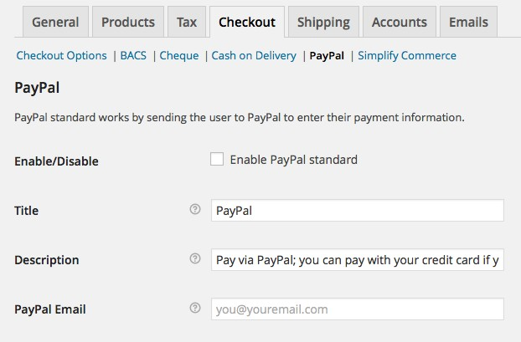

Settings – Checkout – PayPal
Enable PayPal by checking the box

Slide 34
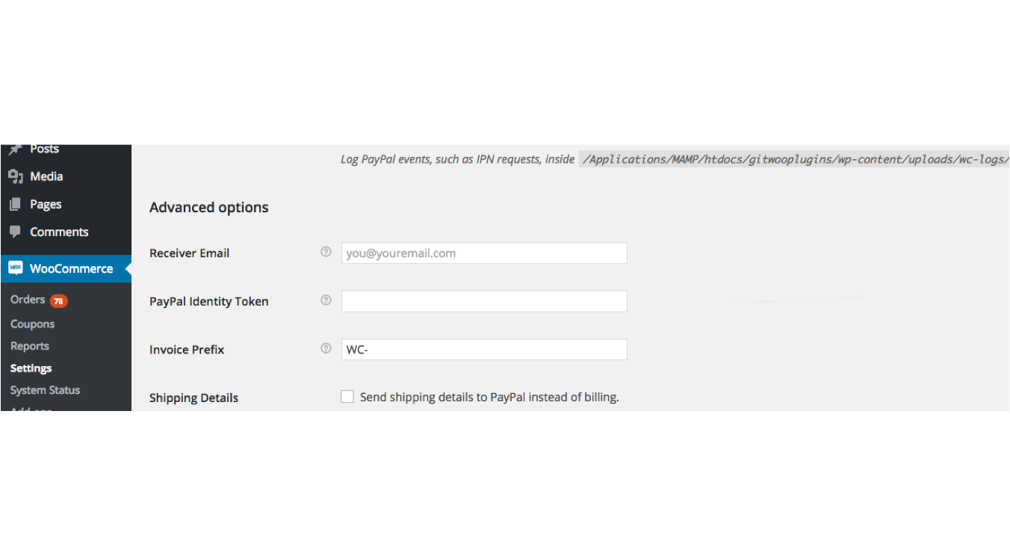
Settings – Checkout – PayPal (cont’d)

Slide 35
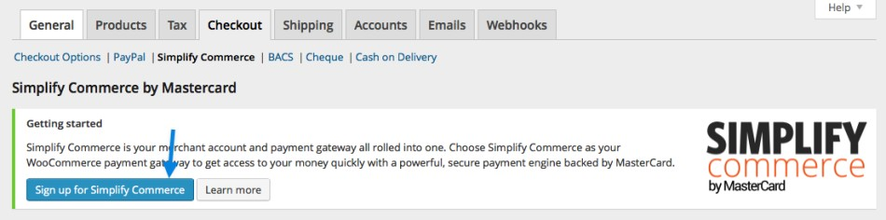
Settings – Checkout – Simplify Commerce
There are other paid credit card payment extensions such as Authorize.net CIM and they have similar settings.

Slide 36
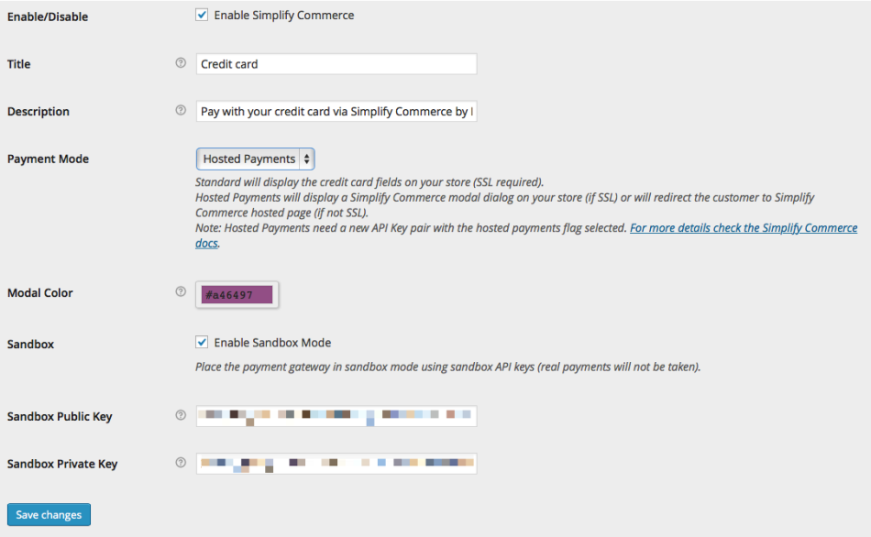

Settings – Checkout – Simplify Commerce (cont’d)
Sandbox is where you can test your payment method without being charged on your credit card.

Slide 37
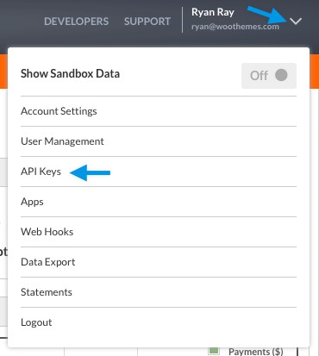
Settings – Checkout – Simplify Commerce (cont’d)

Slide 38
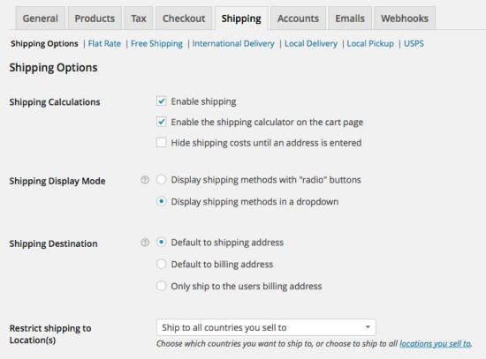
Settings – Shipping – Shipping Options

Slide 39
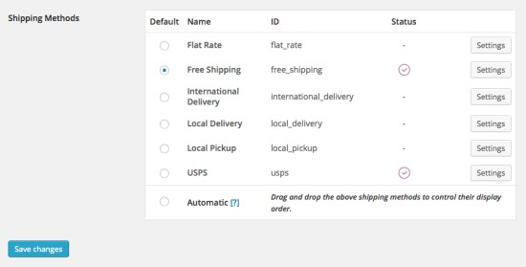
Settings – Shipping – Shipping Options (cont’d)
Drag-­‐and-­‐drop: move the shipping method up and down to set priority

Slide 40
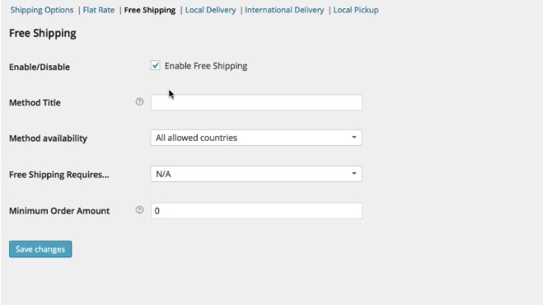
Settings – Shipping – Free Shipping

Slide 41
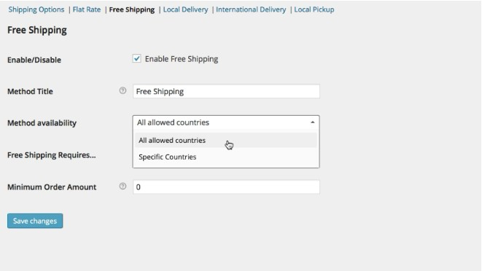


Settings – Shipping – Free Shipping (cont’d)
Enter a title
Select the country(s) that is allowed for free shipping

Slide 42

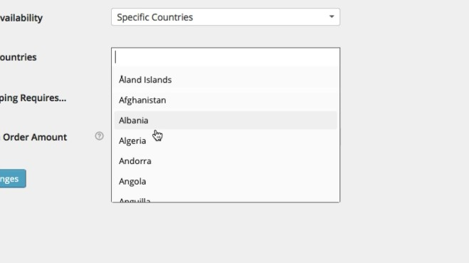
Settings – Shipping – Free Shipping (cont’d)

Slide 43
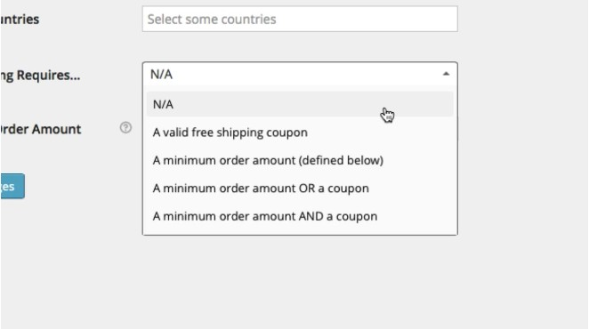

Settings – Shipping – Free Shipping (cont’d)
Select free shipping requirement

Slide 44
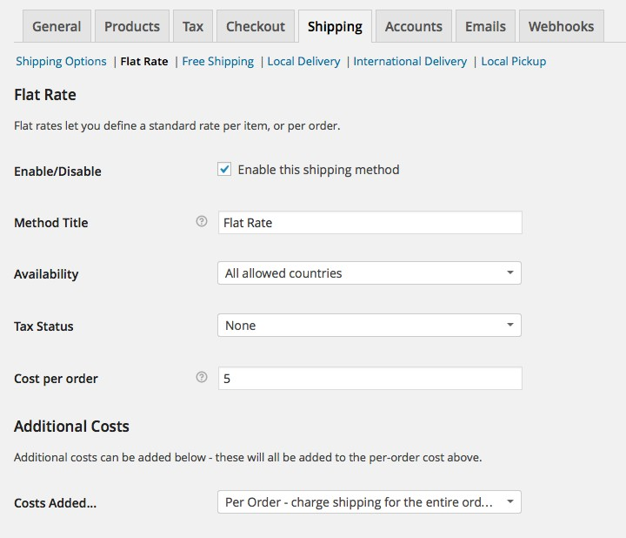

Settings – Shipping – Flat Rate
Enable shipping method by checking the box
Select ‘Per order’, ‘per item’ or ‘per class’

Slide 45

Settings – Shipping – Flat Rate (cont’d)
Add additional rates by adding option name |additional cost [+-­‐percentages%] | per cost type (order, class, item)

Slide 46


Settings – Shipping – International Delivery

Slide 47




Settings – Shipping – Local Delivery

Slide 48


Settings – Shipping – Local Pickup

Slide 49


Settings – Accounts

Slide 50

Settings – Accounts (cont’d)

Slide 51

Settings – Accounts (cont’d)

Slide 52


Settings – Emails – Email Options

Slide 53

Settings – Emails – Email Options (cont’d)

Slide 54

Settings – Emails – Email Sample

Slide 55


Settings – Emails – New Order

Slide 56

Settings - Webhooks
A Webhook is an event notiﬁcation sent to a URL of your choosing. Users can conﬁgure them to cause events on one site to invoke behavior on another.
For more info: http://docs.woothemes.com/document/webhooks/

Slide 57
Agenda
Preparation
Installation
Settings
Products
Other

Slide 58





Products – Creating a Product
Hit “Publish” or “Update” to show the new or revised product
Enter the product name
Enter the product description
Create or select a product cateogory(s)

Slide 59





Products – Product Data - General
Enter a SKU
Enter a regular
price
Schedule a start date and end date for sale
Enter a sale price if the item is on sale

Slide 60





Products – Product Data - Inventory
Enable stock management by checking the box
Enter number of
items in stock
Choose whether backorders are allowed
Choose whether the item is “in stock” or “out of stock”

Slide 61


Products – Product Data – Linked Products
Search for the item(s) you want to upsell

Slide 62

Products – Up-sell Sample

Slide 63


Products – Product Data – Linked Products (cont’d)
Enter the product(s) that is displayed with the cart and related to the user’s cart contents.

Slide 64

Installation – Cart Page

Slide 65

Products – Product Categories and Tags

Slide 66



Products – Publishing Options

Slide 67



Products – Featured Image
Click to add a main image for the item
Enter a short description

Slide 68


Set Up Products – Product Gallery
Click to add other images for the item

Slide 69




Products – Product Sample
Featured image
Short Description
Image gallery

Slide 70


Products – Shipping Classes
Product shipping classes allow you to group similar products for shipping. They work in much the same way as product and post categories.

Slide 71




Products – Shipping and Shipping Classes
Some extension such as Fedex Shipping requires you to enter weight and dimensions
Select a Shipping Class

Slide 72

Products – Bulk Editing Shipping Classes

Slide 73

Products – Bulk Editing Shipping Classes (cont’d)

Slide 74

Products – Shipping Classes – Enabling Debug Mode
WooCommerce > System Status > Tools

Slide 75
Agenda
Preparation
Installation
Settings
Products
Other

Slide 76

Coupons – Enabling Coupons
Make sure the use of coupons is enabled

Slide 77

Coupons – Adding Coupons
Create a coupon by clicking “Add Coupon”

Slide 78


Coupons – Naming Coupons
Enter the name of your coupon. For example: holidays20

Slide 79






Coupons – Coupon Data – General
Enter the coupon amount
Enter the date the coupon should expire. The expiry will occur at 12:00 am on the date chosen.

Slide 80

Coupons – Coupon Data – Usage Restriction

Slide 81

Coupons – Coupon Data – Usage Limits

Slide 82


Orders

Slide 83

Orders – Order at a Glance

Slide 84




Orders – Bulk Actions and Search
Perform bulk actions Sort by dates Search for a customer

Slide 85



Orders – Order Status

Slide 86

Orders – Detail Quick View

Slide 87


Orders – Chosen Shipping Method

Slide 88





Orders – Chosen Payment Method
View Complete Processing

Slide 89

Orders – Individual Order Details

Slide 90


Orders – Changing Individual Order Status
Change order status

Slide 91

Orders – Individual Order Items

Slide 92


Orders – Edits to Individual Order Items

Slide 93

Orders – Adding Fees to Orders

Slide 94

Orders – Processing Refunds
WooCommerce lets you process refunds for PayPal.
WooCommerce > Settings > Checkout > PayPal and set up API credentials

Slide 95


Orders – Processing Refunds (cont’d)

Slide 96


Orders – Processing Refunds (cont’d)

Slide 97


Orders – Processing Refunds (cont’d)

Slide 98

Orders – Individual Order Custom Fields
Create custom ﬁeld on the Orders

Slide 99



Orders – Creating Permissions for Downloadable Items
Search for a downloadable product and grant permissions to download when order status changes to processing/completed

Slide 100



Orders – Order Actions
Perform diﬀerent actions for an order

Slide 101



Orders – Order Notes
Review or delete order notes

Slide 102



Orders – Add Note
Add a note for customer or a private note for other team members

Slide 103

WooCommerce Widgets

Slide 104
WooCommerce Roles
Customer Roles
A customer has read access only, which is used if a user registers via the checkout process. This is equivalent status to a normal blog subscriber.
Shop Manager Role
Shop Manager is a role you can give someone you want to manage the shop but don’t want to make admin. They’re granted the following capabilities:
View, edit and manage orders
View, edit and manage products
View and edit customer info
View and print reports

Slide 105
Agenda
Preparation
Installation
Settings
Products
Misc

Slide 106
THANK YOU!
Sze Liu
Phone: (305) 707-1288
Email: sliu@852cmd.com Social media: @szeliu

